Slide 1
The Choice of Organizational Form: Vertical Financial Ownership Versus Other Methods of Vertical Integration
Joseph T. Mahoney
Strategic Management Journal 13(8): 559–84 (1992)

Slide 2
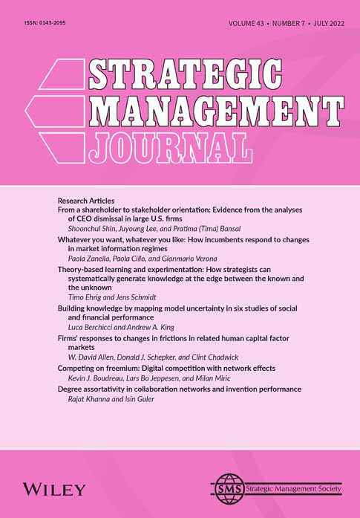
Overview
Synthesize theoretical arguments and empirical findings from the vertical integration literature to identify the underpinning advantages and disadvantages of choosing vertical financial ownership relative to vertical contracts.

Slide 3
Vertical Integration: Motives
Strategic considerations
Raise rivals’ costs by reducing the number of suppliers
Price squeezing --- example: raising the price of crude oil and lowering gas prices
Promote oligopoly by improving the monitoring to maintain price
Output/input price discrepancies
Upstream monopoly prices evaded by vertical integration
Price discrimination --- example; Alcoa vertically integrates into the higher price sensitive market of cookware to avoid arbitrage and sells at a higher price to aircraft manufacturers
Uncertain costs and prices
Transfer risk (supply failure)
Reduce variance of profits
Response to agency problems of measurement and quality uncertainty

Slide 4
Vertical Financial Ownership vs Vertical Contracting
When we abstract from transaction costs, knowing the motive for vertical integration cannot help us in predicting or prescribing organizational form. Conversely, knowing the organizational form cannot help us to infer the motive.
In the absence of transaction costs, vertical contracting can replicate the advantages of vertical financial ownership (Coase, 1937, 1960).
Exclusive dealing contracts
Licensing contracts
Resale price maintenance
Territorial restrictions
Tying contracts

Slide 5
Agency Theory
Mathematical Principal-Agent Model
Unbounded rationality
No difference in the costs between long-term contracts and hierarchy
The firm as a “nexus of contracts”
Positive Agency Theory
Subset of transaction costs --- focuses on ex ante transaction costs (monitoring costs, bonding costs, and residual loss)
Organizational form matters

Slide 6
Vertical Financial Ownership: Advantages
Transaction costs motives
Mitigate market frictions and market failures
Contractual holdup problems: asset specificity (human, physical, and site)
Economies of scope in the presences of strong market frictions
Profit
Preemptive claims on profits between separate firms are eliminated
Coordination and control
Authority relationship within firms
Disputes settled more efficiently

Slide 7
Vertical Financial Ownership: Advantages
Audit and resource allocation
Integrated firms have superior information upon which they can base allocations to their divisions due in part to superior auditing capabilities
Improved information enables the firm to allocate personnel to tasks more effectively
Motivation
Quasi-moral involvement --- equity and due process
Communication
The development of a coding system, which increases communication efficiencies and provides stability in operations

Slide 8
Vertical Financial Ownership: Disadvantages
Bureaucratic costs
Difficult to anticipate
Internal organization more costly than the market mechanism
Overestimated and not necessarily compensate for higher costs
Strategic costs
Loss of access to information and tacit knowledge
Specialized asset → Increase sunk cost, chronic excess capacity, and low profitability
Decrease in strategic flexibility
Production costs
Cost disadvantage if not using enough output
Capital drain
Capacity imbalance → higher production costs

Slide 9
Framework For Predicting Organizational Form
Agency theory: Emphasizes information asymmetry
Non-separability problem in team production makes it difficult to infer input effort by observing the output
Task programmability --- difficulties when observing the input
Transaction costs approach
Asset specificity (physical, human, site)
Uncertainty (demand and technological)

Slide 10
Framework For Predicting Organizational Form
Transaction costs approach (Williamson 1979) provides insight into the key role of asset specificity but neglects the interactive effects of measurement problems.
Positive agency theory emphasizes measurement costs, but neglects asset specificity.
Combine these two efficiency perspectives → Predictions and prescriptions on make-or-buy

Slide 11
Predicting the organizational form of vertical coordination
Low task programmability: Observing input (effort) is a poor measure for making rewards.
High nonseparability: Observing output is a poor measure for making rewards.
High specificity: Human, physical and/or site firm-specific investments are high.
Spot market: The price system works smoothly.
Long-term contract: Obligations of principals and agents are specified and enforced by third-parties (courts)
Relational contract: Obligations of principals and agents are specified and self-enforced. Social conditioning applicable.
Inside contract: A hybrid arrangement between contract and hierarchy that is best described as a 'manager as monitor’ setup.
Joint ventures: An equity agreement whereby a separate entity is created.
Hierarchy: A superior-subordinate relationship; financial ownership.
Clan: Organization that is based on a vital sense of human solidarity.

